Slide 1
DOELAP External Dosimetry Training Travel Topics
Idaho Falls, ID
September, 2024

Slide 2
Travel Contact
Tina Wagoner
wagonetl@id.doe.gov
(208) 526-0423
1955 Fremont Ave.
MS 1240
Idaho Falls, ID 83415

Slide 3
Funding for Assessor Travel
DOELAP reimburses travel expenditures that are considered customary and necessary for the completion of duties.
If you mix business and pleasure travel, you must get approval from STM and get a theoretical estimate of costs for DOELAP travel vs. costs for travel including personal dates
Driving POV vs. flying
Reimbursement for lesser of the two
The traveler pays the difference between the theoretical DOELAP-only dates travel fare and the cost for the dates of personal travel or POV
Also extra hotel nights, fuel, etc.

Slide 4
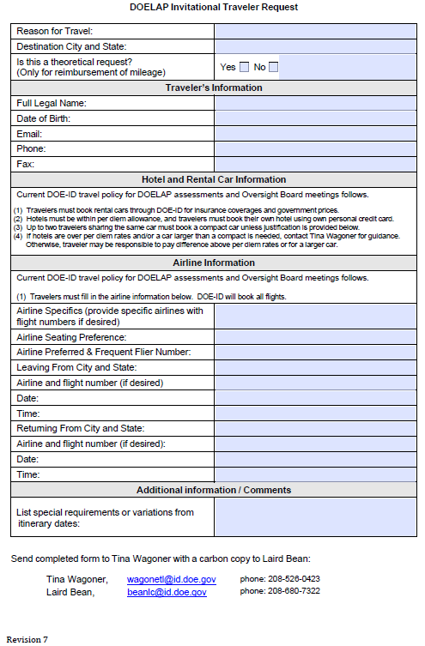
DOELAP Invitational Traveler Request

Slide 5
Travel Requests
Lead assessor coordinates with other assessors (and site if desired) to choose an appropriate hotel.
Travelers should make all efforts to get government per diem rate
Be aware, the per diem is where the hotel is located, not where you fly into
e.g. fly into Chicago, stay in Indiana
If government rate is unavailable, over per diem may be authorized
Tina needs to have hotel price per night prior to completing the travel authorization (over per diem must be approved in advance)
Travelers are responsible to make their own hotel reservations
Tina makes rental car and flight reservations
Don’t make your own flight reservations
Identify taxi, uber, POV mileage (both ways), airport parking, etc. for transportation between home and airport
The sooner the better

Slide 6
Rental Car/Local transportation
One car per team
Rental car typically is reserved under Lead Assessor’s name, but be sure to let Tina know who should be assigned
Travelers must use the LEAST expensive compact car available
If more than 2 assessors are going a larger car may be justified
Indicate assessment duration
Submit justification for rental car
Basic justification (1 car per team, travel between hotel and site)
If possible, identify any known airport, hotel, or other parking fees that will be necessary

Slide 7
Rental Car/Local transportation
If someone other than a DOELAP person needs to ride in the car (spouse, etc.) you will need to reserve your own car
Identify receipts for
Rental car gas
Shuttle to/from airport
Taxi to/from airport
Travelers will NOT be reimbursed for purchasing pre-paid refueling options. Travelers should refuel prior to returning an approved rental vehicle
Taxi for meals is not reimbursable

Slide 8
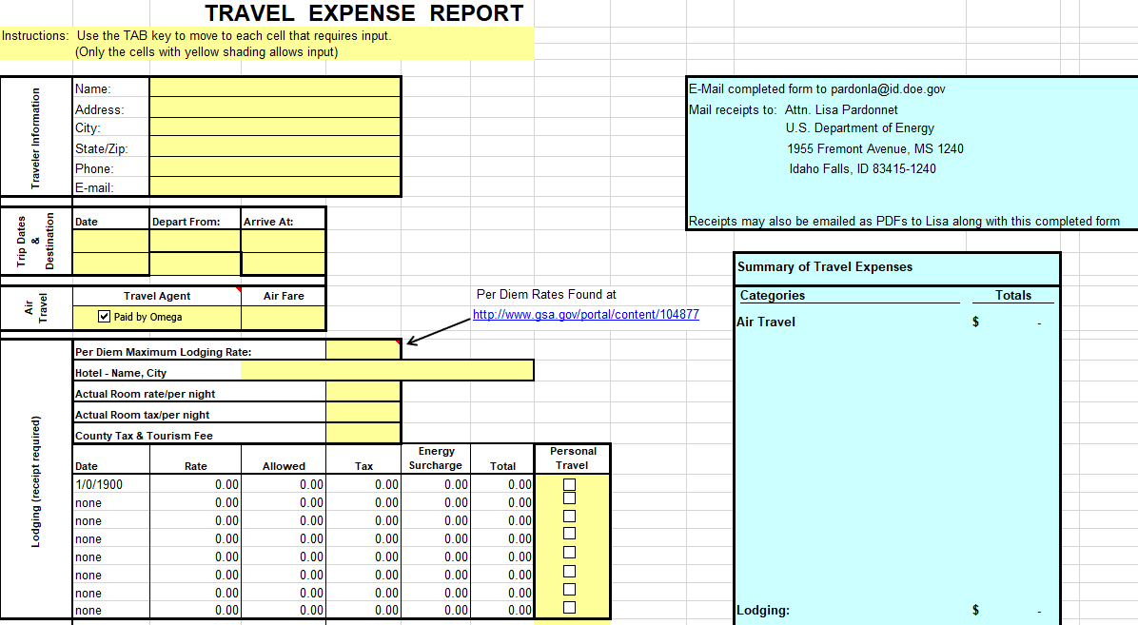
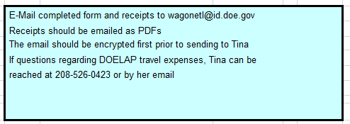
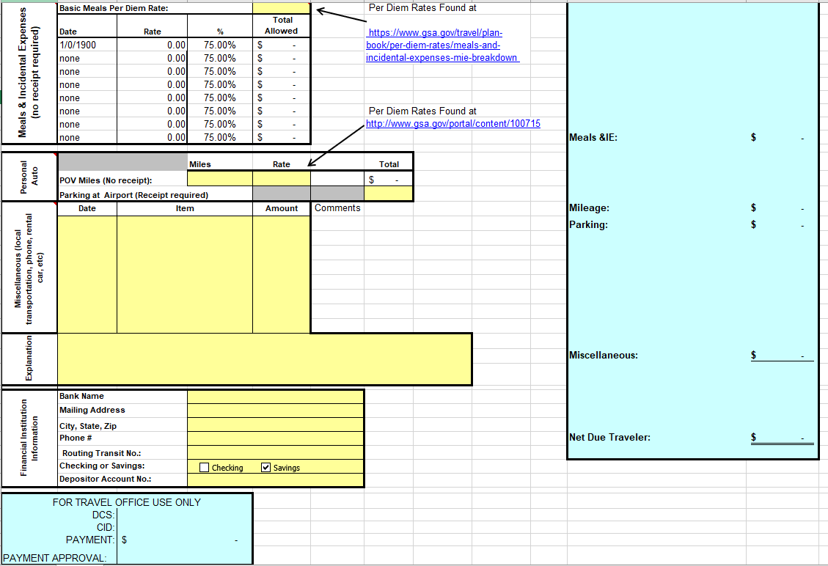
DOELAP Travel Expense Report

Slide 9
Travel Voucher submission
Per Travel Policy, travel vouchers need to be completed within 5 days after the completion of the travel, so submit for reimbursement ASAP upon completion
For this travel there will only be one week before we will be closing things for the end of the fiscal year, so all travel vouchers must be completed and approved by September 23rd to give time for processing
If they are not completed by September 23rd, then we will have to wait until mid-October to complete the vouchers

Slide 10
When Travel Goes Wrong
Personal issues
Flights delayed/cancelled
After the airline ticket has been issued, if you have any travel issues after hours call Adtrav, 888-205-2369
Rental car accident
Other issues?

Slide 11
Questions?

